Slide 1


WELCOME TO RESEARCH COMPUTING SERVICES

Slide 2
Housekeeping
Bathrooms
In case of emergency: 1888 Lawn is our Evacuation Point
Photos: If you don’t want your photo taken, let us know!

Slide 3
Let’s Learn NVivo!
Intermediate Training

Slide 4

About Me!
Media and Communications Researcher at the Digital Studio
Research Assistant
NVivo and Omeka Research Community Coordinator
Dog person
You can follow me on twitter @alexshermon, on LinkedIn at linkedin.com/in/alexshermon/ and can get in touch via email at alex.shermon@unimelb.edu.au

Slide 5
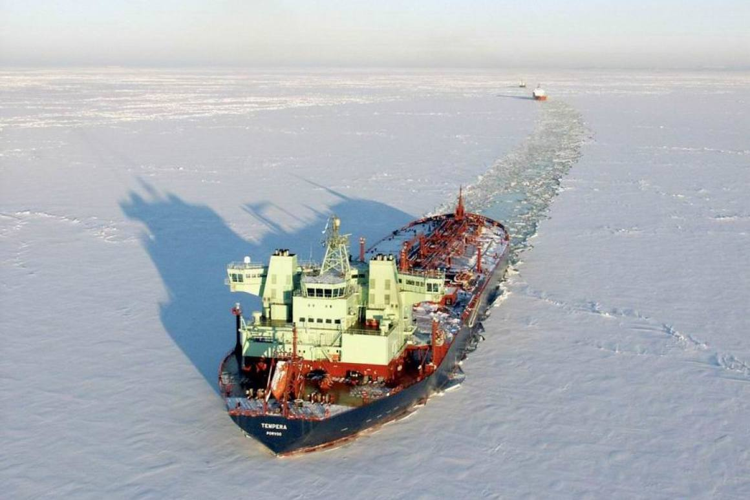
Icebreakers (yay)
Name
Faculty
Research

Slide 6

Learning Objectives
Cases and Case Classifications
Sentiment Analysis
Visualisations
Charts
Hierarchy Charts
Cross tables
Memos and Annotations

Slide 7
Cases and Case Classifications

Slide 8

What are Cases?
Cases are the 'units of observation' in your research study. They might represent:
people
places
events
organizations
Cases are a type of node. Cases can sometimes be referred to as “case nodes”

Slide 9

What are Case Classifications?
Person
Case classifications let you store demographic information about the 'units of analysis' in your project.
For example, you could create cases for your interview participants, assign these cases to a classification called Person, and record values for Age, Gender, and occupation (these are called attributes)
What attributes are relevant depends on your research!
Academic Track Stage
Faculty
Gender

Slide 10
The Difference between Cases and Classifications
Case Classification = People
Cases = Barbara, Charles, Dorothy, Margaret
Cases are the individual instances (or units) of a classification

Slide 11
Challenge 1: Creating Cases
Import the sample interviews from: http://go.unimelb.edu.au/o3vr
Create a case classification for person (or import if on windows)
Code the sample interviews at case nodes
Adjust the case attributes of your case nodes

Slide 12
2. Sentiment Analysis

Slide 13

Why use Sentiment Analysis?
Thematic coding at nodes doesn’t tell you the attitude towards the node
Sentiment nodes help you to organise attitudes towards themes

Slide 14
Challenge 2: Sentiment Analysis
Open the “Sentiment” tab under Codes
Try to code a few of the interview transcripts under sentiment nodes

Slide 15
10 Minute Tea Break

Slide 16
3. Visualisations

Slide 17
What do Visualisations do in NVivo?
Visualisations in NVivo help you to:
Explore your data
Conduct analysis
Compare your data
Visualisations in NVivo work a lot better if you have coded both nodes and cases with meaningful attributes

Slide 18
Challenge 3: Creating a Hierarchy Chart
Open up the Sample Project
Using the Explore tab, create a Hierarchy Chart
Challenge 4: Creating a Bar Chart
Using the chart button in the Explore tab, create a few charts
Try to adjust the appearance of the bar chart

Slide 19
Challenge 5: Cross Tables
Using the Explore tab (I think it’s in queries on Mac), create a cross table between cases and nodes
Adjust the colour of the cross-table
Adjust the cell values to a percentage
Extension: Try to create a cross table with two different attributes

Slide 20
4. Memos and Annotations

Slide 21

What are Memos?
You can use memos to record ideas, insights, and interpretations of your data. By keeping this analysis separate from your data, you can have a clear sense of what you’re “getting out” of your research. Memos can also be used in team projects to keep track of changes and ideas.
You can link memos to materials, or leave them to stand on their own.

Slide 22
Challenge 6: Creating and Linking Memos
Create a new memo
Link that memo to a file
Hint: Link the memo from the file itself, not the memo window

Slide 23
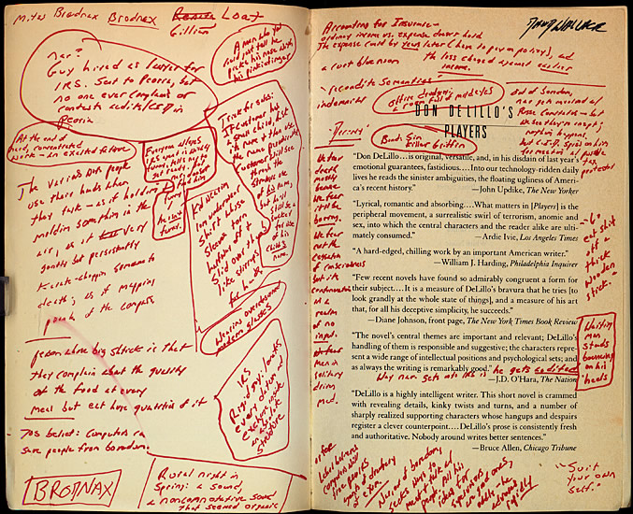
What are Annotations?
Like memos, annotations let you jot down insights and ideas attached directly to the material that you are analysing

Slide 24
Challenge 7: Creating Annotations
Highlight some text in a file and write an annotation for it
Toggle annotations on in the “view” section

Slide 25
Let’s Look Back!

Slide 26

What have we learnt today?
I know how to code:
Cases
Sentiment Analysis
I know how to visualise with
Hierarchy Charts
Bar Charts
Cross Tables
I know how to record:
Memos
Annotations

Slide 27
What do we do next?
Congratulations! You are the first group to complete my introductory and intermediate NVivo training and the final workshop for 2019!
Next year:
I need ResLeads to help out at workshops and run advanced meetups on specialised features of NVivo
Drop-in sessions where we can provide more personal support
Faculty-tailored workshops
Web Resources for NVivo at UniMelb (Particularly for Mac users)

Slide 28
Becoming a ResLead
ResLeads are community members who help out at workshops and take an active role in the NVivo community at the University of Melbourne:
I found that teaching a tool was the best way to learn!
Paid opportunities to present at meetups and University events
Get involved in promoting the community in your faculty
If you’re interested in becoming a ResLead, have a chat with me at the end of this session, or send me a message on twitter @alexshermon or via email at alex.shermon@unimelb.edu.au

Slide 29
Feedback!
Your feedback is so useful for me, especially in these early workshops where I’m figuring out what works and what doesn’t. Please take a few minutes before you head off to fill in the feedback form:
go.unimelb.edu.au/bym6
Make sure to select NVivo Intermediate Training and not the Introductory one

